Slide 1
SMART QUEUE SHOPPING

Slide 2
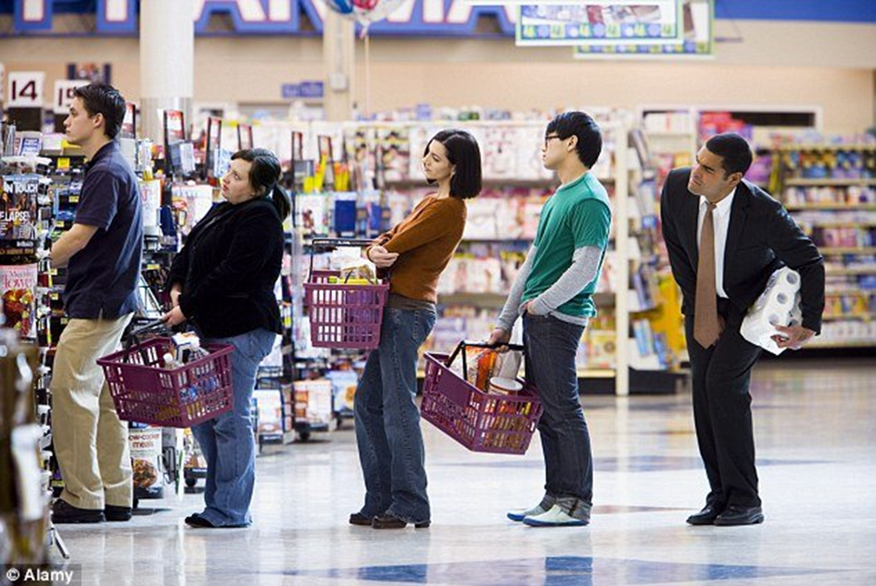

AIM AND OBJECTIVE

Slide 3
LITERATURE REVIEW
Radhika Kulkarni et al [1] have implemented a electronics hardware system with Radio frequency identification reader fitted in the trolley to avoid long queues at the billing desk. They have attached tags to all the products available for sale. They will directly sent the bill to the counter and customer has to only pay at the billing section.
Amine karmouche et al [2] have designed such a RFID system that is able to scan moving and static products in the shopping space using RFID reader antenna. Customers can conduct their purchases by putting products in their carts and display the total of their bill in a cart embedded touchscreen.

Slide 4
LITERATURE REVIEW
Amazon’s[3] has recently launched “Amazon-Go” where it uses image processing, neural networks, deep learning algorithms, sensor fusion, to predict the item a customer picks and adds it to your virtual basket, and after that a customer can move out with the shopped products and money is deducted from his Amazon wallet .
G,SriHarsha et al [4] have introduced a RFID smart shelf design in which UHF RFID tagged object can be located precisely among neighbouring object throughout the shop.
Panasonic[5] a Japanese company, has introduced a “cashier free convenient store concept” using UHF RFID tagged product, scanned while putting it in the trolley.

Slide 5
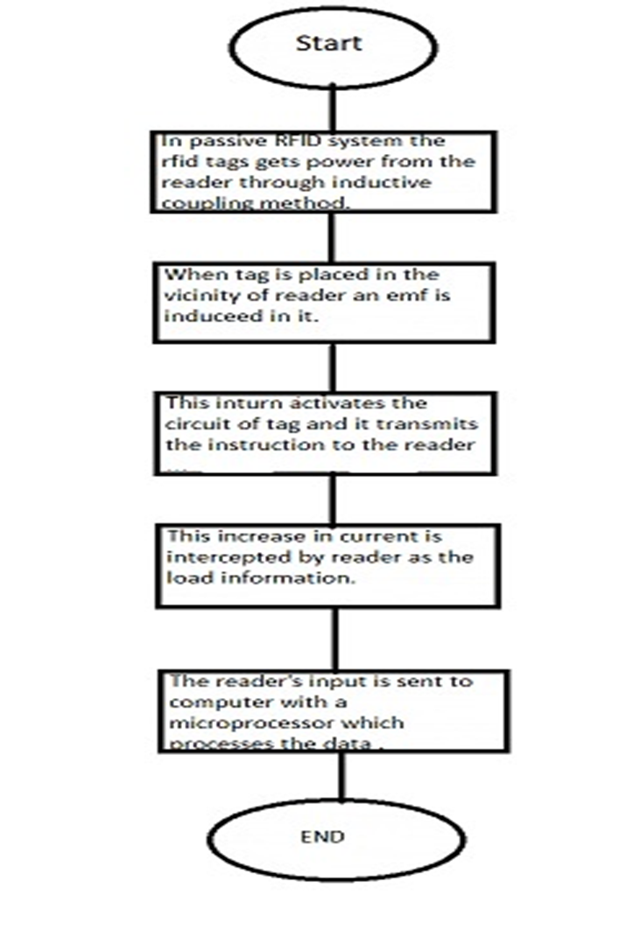
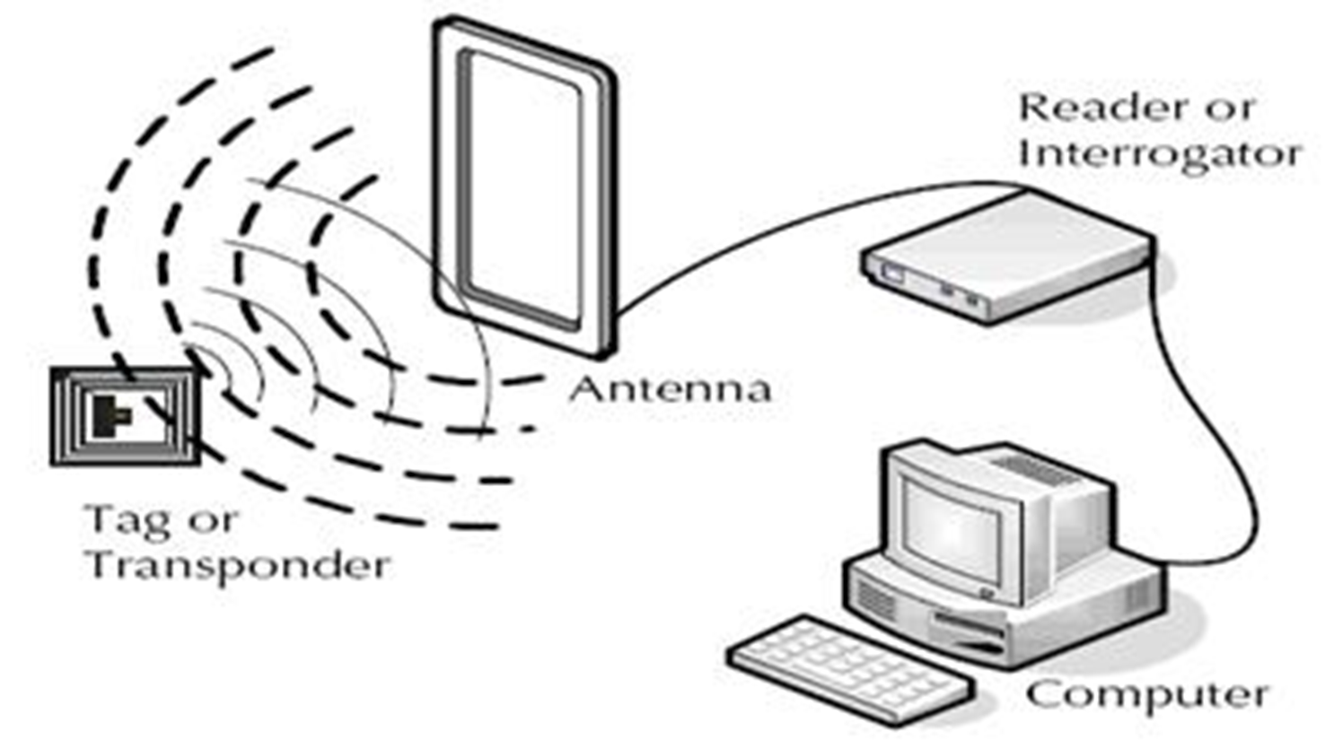
WORK FLOW

Slide 6
SPECIFICATIONS
SPECIFICATION
Tag Type | Passive
Region | Global
Tag Form Factor | Hard Tag
Applications | Inventory management
Frequency Band | UHF- (860-960 MHz)
IC Type | Impinj/Monza4D, 4E, 4QT

Slide 7
PROTOCOL
Specifications
Protocol | EPC Global Class 1 Gen 2
Air Interface | ISO 18000-6C
Encoding Type | PIE (Pulse interval encoding) AND FM0 (Bi- Phase Space coding)
Modulation | ASK ( Amplitude shift key)
Anti Collision Algorithm | Q Algorithm

Slide 8
ALGORITHM
Socket is created first to establish the connection between the computer and the reader.
Unique EPC global ID of every RFID tag (present in the vicinity of the antenna) is received and stored in a list, as per the command of the user.Then every tag ID is searched in the dataset to get the other product details.
Total cost is calculated using those details.
These details is listed, bill is prepared and uploaded to google sheets in real-time.
The process from step 2 to step 5 is repeated.

Slide 9
DIFFERENTIATING FACTORS
Cost
Compatibility with existing infrastructure
Less Maintenance required

Slide 10
REFERENCES
https://www.cse.wustl.edu/~jain/cse574-06/ftp/rfid/index.html
https://www.geeksforgeeks.org/socket-programming-python/
https://pypi.org/project/gsheets/
https://www.youtube.com/watch?v=7I2s81TsCnc

